Slide 1
ISSC – Lotus Domino/Notes Development Introduction
Ren Rong
November 7, 2026

Slide 2
Agenda
1: Overview 20mins
2: Notes Designer Introduction 15mins
3: Design Elements Introduction 3 hrs
4: Exercise & QA 3 hrs
5: GNA Standard 30mins

Slide 3
Agenda
1: Overview
2: Notes Designer Introduction
3: Design Elements Introduction
4: Exercise & QA
5: GNA Standard

Slide 4
Overview – Definition
What is Lotus Domino/Notes?
Lotus Domino/Notes is an integrated messaging and Web application software platform for companies that need to improve customer responsiveness and streamline their business processes.

Slide 5
Overview - Feature
Email System
Multi-Platform
Architecture ( C/S , B/S)
Document Database(Non-RDB)
Workflow
Cooperation Work
Full-text Search
Web server
Replication
High Security

Slide 6
Overview – Family
Lotus Domino/Notes Family
Domino R6 Message Server
Domino Utility Server
Domino Enterprise Server
Lotus Notes 6 Client
Domino Designer 6
Domino Administrator 6
Mobile Client
iNotes Web Access
iNotes Access for Microsoft Outlook

Slide 7
Overview - Language
Formula
Lotus Script
Java
Java Script
HTML
OLE
XML
CGI
JSP

Slide 8
Overview - Others
Connect to enterprise application
  Domino Enterprise Connection Services (DECS)
  @DB commands
  Data Connection Resource (DCR)
  Lotus Script and Java Class
  Domino Connectors
  Lotus Enterprise Integrator (LEI)
Exporting and Importing
Item
  Represents a specific piece of data in a document
  The client interface displays items in a document through fields on a form
  When a field on a form and an item in a document have the same name, the field displays the item
  All items are accessible through LotusScript, Java or other program

Slide 9
Agenda
1: Overview
2: Notes Designer Introduction
3: Design Elements Introduction
4: Exercise & QA
5: GNA Standard

Slide 10
Develop Tool - Designer
An integrated application development environment
Design Elements
  Form
  Page
  View
  Folder
  Agent
  Frameset
  Navigator
  Outline
  Share Resources

Slide 11

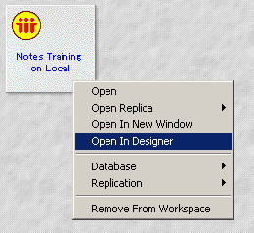
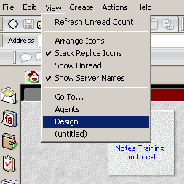
Develop Tool - Designer
Starting Lotus Domino Designer
  From file system
  From bookmark bar
  Click the bookmark to start designer.
  From a database

Slide 12
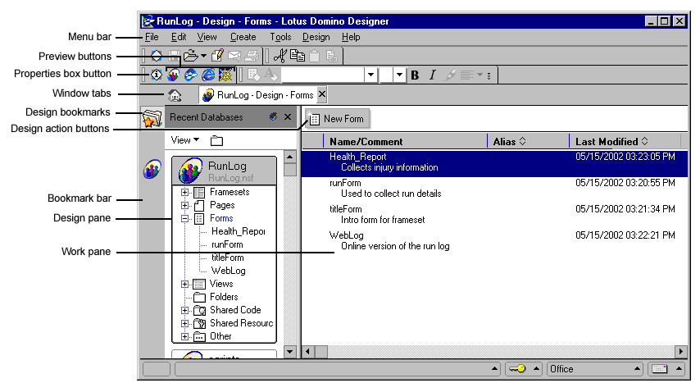
Develop Tool - Designer
Exploring Designer

Slide 13
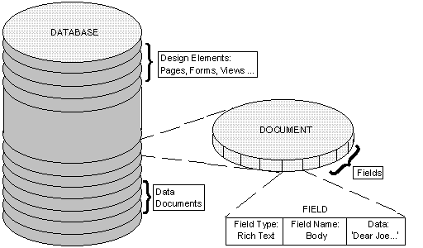
Develop Tool - Designer
How to organize an application

Slide 14
Develop Tool - Designer
How to create a database
  Create your own
  File - Database – New
  Select Blank from the template list, and click “OK”.
  Using a template
  File – Database – New
  Select a template file from the template list, and click “OK”
  Copying a existing database
  Copy the whole database
  Copy some design elements

Slide 15
Agenda
1: Overview
2: Notes Designer Introduction
3: Design Elements Introduction
4: Exercise & QA
5: GNA Standard

Slide 16
Design Elements
Database
  Properties, Icon, Database Script, About/Using document
  Synopsis
Form
Elements for Display use
  View / Folder
  Navigator/Form/Page/Frameset/Outline
Others
  Agent
  Script Library
  Share Resources (Image, File, Applet, Data connection)

Slide 17
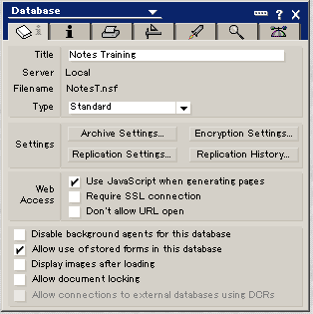
Design Elements - Database
Database
  Properties
  1) The Basics Tab contains information about the database, such as its title, location, database name, database type, the replication setting.
Use JavaScript when generating pages.
Allow document locking: Protect design elements.
Allow connections to external database using DCRs

Slide 18
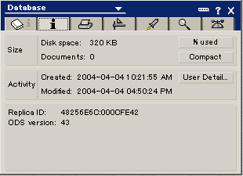
Design Elements - Database
2) General Database Information Tab
  ODS version: On Disk Structure version
  43: R6 or higher; 41: R5; 20: R4

Slide 19
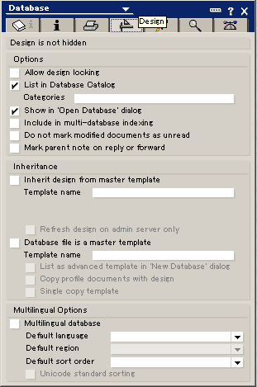
Design Elements - Database
3) Design Tab
  Allow design locking
  Inherit design from template
  Multilingual options

Slide 20
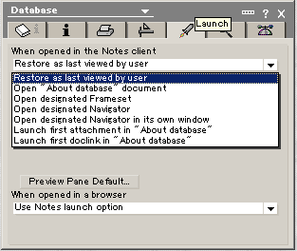
Design Elements - Database
4) Launch Tab
  Define what users will see when they open the database

Slide 21
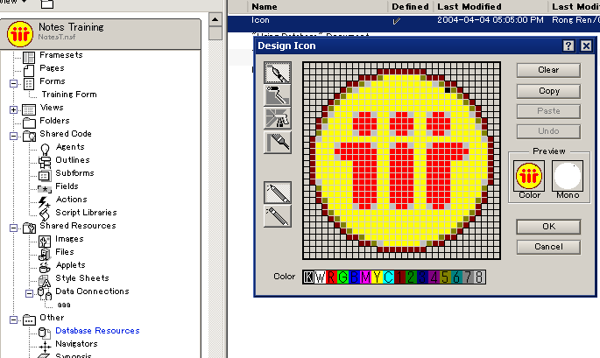
Design Elements - Database
Database
  Icon

Slide 22
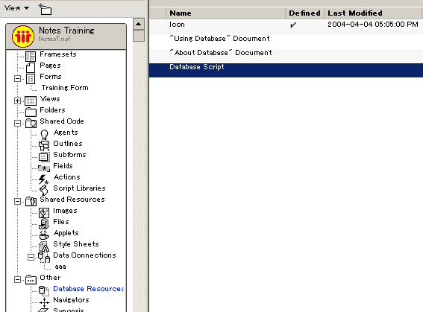
Design Elements - Database
Database
  Database Script
  Lotus Script programs that are associated with events for the Database object,
  such as opening or closing a database, deleting documents.
  About document: Describe the purpose of a database
  Using document: Provide users with instructions using application.

Slide 23
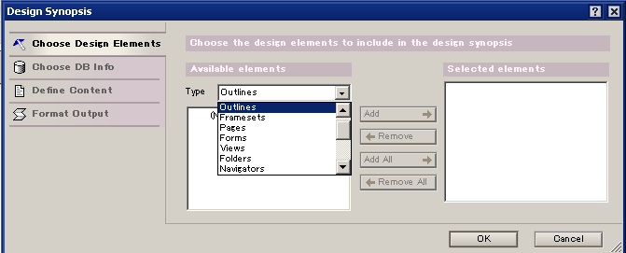
Design Elements - Database
Database
  Synopsis
  Generate a detailed report on a database.

Slide 24

Design Elements - Form
Form
  Function
  Collection information
  Provide structure for creating and displaying documents
  Create a form
  Create new form
  Click the “New form”.
  2) Copy a existing form

Slide 25
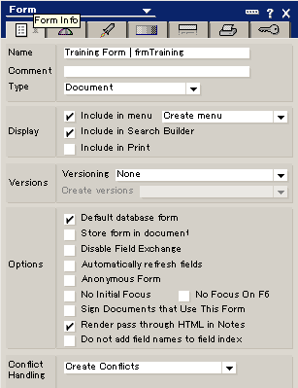
Design Elements - Form
Form
  Properties
  Form Info Tab
  1) Form name: XXXX | AAAA
  Name: XXXX; Alias name: AAAA
  2) Type
  Document
  Response
  Response to Response
  3) Merge conflict
  4) Automatically refresh fields

Slide 26
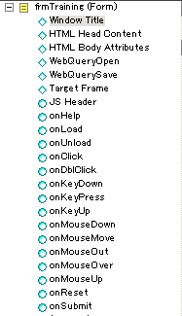
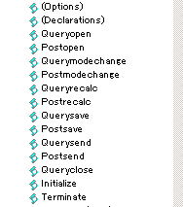
Design Elements - Form
Form
  Events

Slide 27
Design Elements - Form
Form
  Form elements
    Field
    Table
    Action
    Computed text
    Graphics
    Embedded elements
    HTML / Java script / Applets
    Layout region
    Section
    Sub form
    Shared resources

Slide 28
Design Elements – Form - Field
Field
  Collect data
  Field can be created on forms, sub forms, or in layout regions.
  When a user, either in a Notes client or a Web browser, creates a form, fills out the information in the fields, and saves the form, the data in the fields is stored in an individual document.
  The contents of the fields can then be displayed in documents and views or can be retrieved for use in formulas.
  A field can be used on a single form, or you can create shared fields for use in multiple forms in a database.
  Single – use field
  Open form → Select “create->field” → Assign name/type to field
  Shared field
  Click on fields in Shared Code → New Shared Field → Assign name/type

Slide 29
Design Elements – Form - Field
Field
  Naming a field
  A field name must begin with a letter or the symbols _ and $ and .
  A field name can include letters, numbers, and the symbols _ and $ and .
  A field name can contain up to 32 bytes
  Field name cannot contain spaces
  Field names cannot be same in a form
  If several fields on forms in a database contain similar information, for example, the date of creation and the author's name, suggest to use the same field name for all of them.

Slide 30
Design Elements – Form - Field
Field
  Field types
  Text / Rich Text / Rich Text Lite
  Number
  Date/Time
  Checkbox / Combo box / Dialog list / Radio Button / List box
  Names / Readers/ Authors
  Time zone
  Color
  Password
  Formula

Slide 31
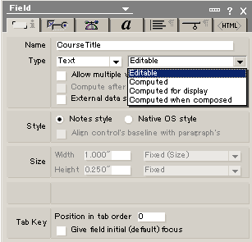
Design Elements – Form - Field
Field
  Text
  Please see the detailed show.

Slide 32
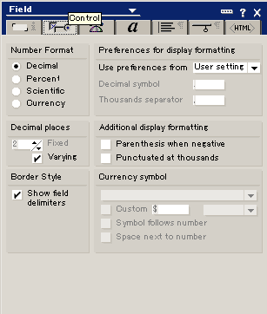
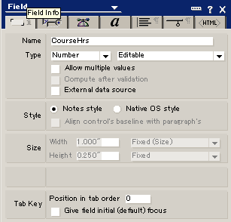
Design Elements – Form - Field
Field
  number
  Please see the detailed show.

Slide 33
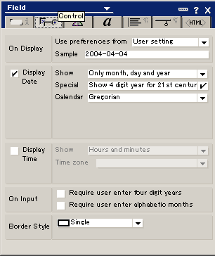
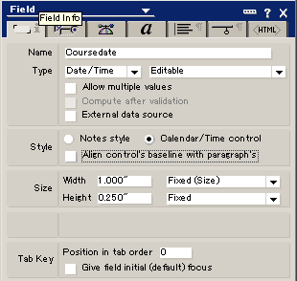
Design Elements – Form - Field
Field
  Date/Time
  Please see the detailed show.

Slide 34
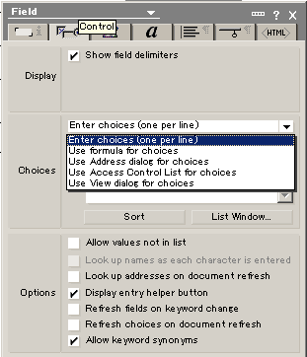
Design Elements – Form - Field
Field
  Dialog box
  Please see the detailed show.

Slide 35
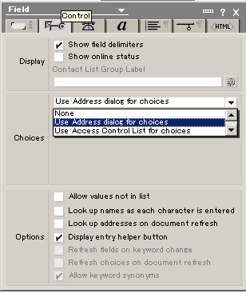
Design Elements – Form - Field
Field
  Names
  Please see the detailed show.

Slide 36
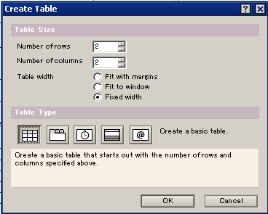
Design Elements – Form - Table
Table
  Format display
  Create a table
  Create → Table
  Select table size
  Select table type.

Slide 37


Design Elements – Form - Table
Table
  Table type
  A basic table
  Tabbed table. Display each row as a clickable tab.
  Animated table. Display each row for two seconds.
  Caption table. Display each row as a clickable caption.
  Programmed table. Display one row based on a field value.

Slide 38
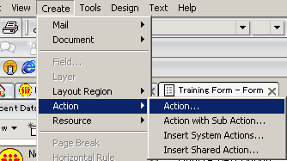
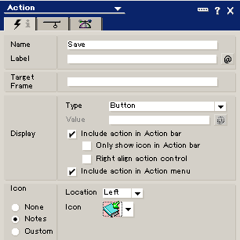
Design Elements – Form - Actions
Actions
  Create actions
  Action properties

Slide 39
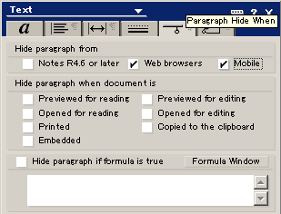
Design Elements – Form
Hiding paragraph

Slide 40
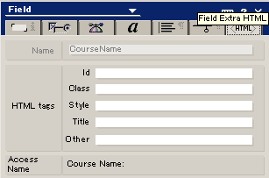
Design Elements – Form
HTML tab
  For field only
  For web use only

Slide 41
Design Elements – View
View
  A view is a sorted or categorized list of documents.
  Views are the entry points to the data stored in a database.
  Every database must have at least one view.
  View type
    Standard outline view
    Calendar view
    Shared view
    Private view

Slide 42
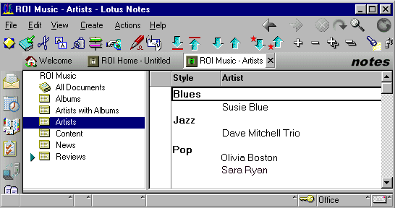
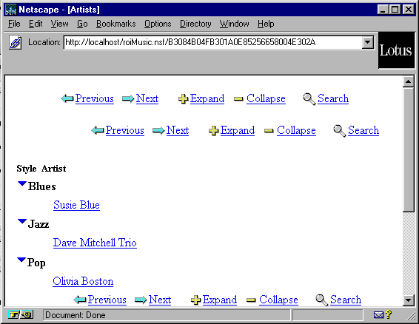
Design Elements – View
Standard outline view

Slide 43
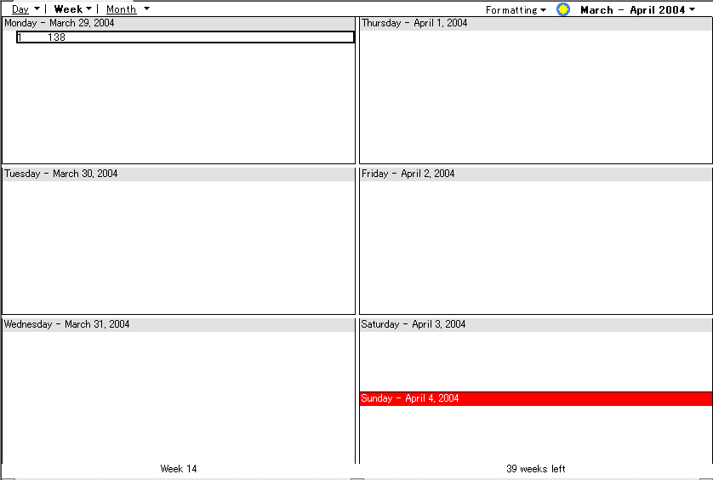
Design Elements – View
Calendar view

Slide 44
Design Elements – View
Shared and Private view
  Shared views are available to any user with at least Reader access to the database.
  Private views are available to one person.
  Private views are not supported on the Web.

Slide 45
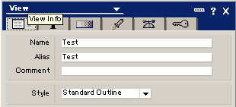
Design Elements – View
View properties
  View Info Tab
    Name
    Alias
    Memo: If the name is remarked with the “(“ and “)”, then the view is not eyeable on Notes client.

Slide 46
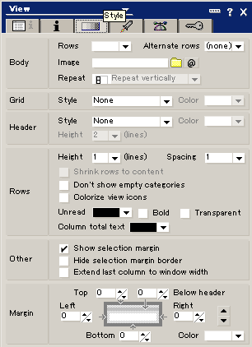
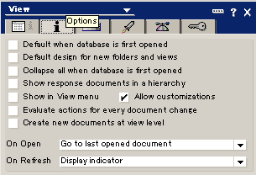
Design Elements – View
View properties
  Options and Style Tab
    In the two tabs, you can define view’s display properties and styles.

Slide 47
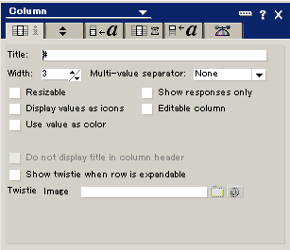
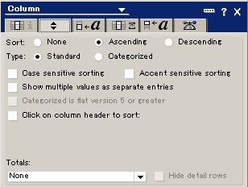
Design Elements – View
View Column
  Column properties
    Here, you can define column title, width, sort, type, style……

Slide 48
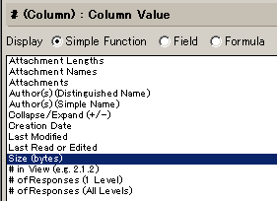
Design Elements – View
View Column
  Column value
    Here, you can set the value of column with simple function, definition fields and formula. For example, the formula “@username” is as the value of column, then the column will display current user name.

Slide 49
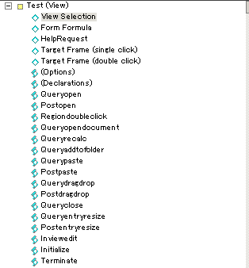
Design Elements – View
View actions
Same as one of the form
View event
  View selection
  In the section, you can program it to show all documents or only certain documents in the database. For example,
  SELECT @All , SELECT Form = “frmTraining”

Slide 50
Design Elements – View
Folder
  Folders are containers used to store related documents or groupings of documents.
  Folders have the same elements as view and are designed much the same way.
  When the documents in folder are removed, the documents are in the view still.
  When the documents in view are removed, the documents don’t exist.
  For folder, there are some special formula or LS, such as,
  @Command( [Folder] ; folderName ; moveOrCopy )
  @Command( [FolderDocuments] ; folderName ; moveOrCopy )

Slide 51
Design Elements – Page
Page
Pages and forms are similar in certain ways. A page is a database design element that displays information. Pages can be used anywhere in your application that you have text, graphics, or an embedded control, such as an outline, to present to the user.
  Elements to use on page
  Same as on form.
  Action, Computed text, applets, Graphics, HTML, JS, Embedded elements,
  Text, CSS ……
  No Fields

Slide 52
Design Elements – Navigation
Navigator
A navigator is a graphical road map that directs users to specific parts of an application. A navigator -- similar to a form, a page, or a view -- is an independent design element and combines graphics, text, and action buttons. Navigators can also be embedded in a form or a page. One disadvantage of navigators is that once you design a navigator, it is usually static and can be difficult to change.
Outline
An outline lets you create an organizing structure for an application and gives you control over how elements display in a navigation pane. An outline also gives you the power to create a sophisticated site map that combines text, graphics, and automation, and lets you combine database elements with links to Web sites and to pages, documents, or views in other databases.
Imagemap
An imagemap can reside only on a form or a page.

Slide 53
Design Elements – Others
Agent
Use agents to set up user-activated tasks, or background tasks, in any part of a Domino application. Agents can be simple, such as moving documents to a folder, or complex, using Java programs to run multiple automated tasks at scheduled times. Agents are stored with databases, but you can use them to run automated tasks for views, documents, fields, and databases.
Script Library
  A common resource for other program invoking.
  Can contain LotusScript, Java, or JavaScript
  The scope of a script library is the current database.
Share Resources

Slide 54
Q&A
Any Questions?

